Slide 1

Corruption
Bernard Yeung
NUS Business School, ABFER, CEPR
(Chen Lin, Randall Morck, Bernard Yeung, Xiaofeng Zhao)
Copyrights Bernard Yeung 2015

Slide 2
Asian decade of reforms
  China, India, Indonesia
    Anti-corruption → the rule of law, merit based resource allocations
      If so, strong population dividends for India, Indonesia, and great long term growth for China
Why is corruption bad?
Why is getting rid of corruption hard?
Really? event studies on China’s anti-corruption
Copyrights Bernard Yeung 2015

Slide 3
Why is corruption bad (MTIC)?
Moral, ethics issue
High transaction cost (a transparent tax is more efficient than a “corruption tax”, e.g., Dilip Mookherjee and I. P. L. Png 1995, EJ)
Inefficient distribution of resources
  Not merit based, favor large groups with high current wealth (Shleifer and Vishny “Corruption, QJE 1993 Aug, Morck and Yeung, 2004)
    lower transaction costs
      Easier to conceal
      More credible commitment
      Lower cost to raise financing (bribery)
  → “institutionalized bias”, inefficient distribution of resources
Copyrights Bernard Yeung 2015

Slide 4
Skew Human Capital Development
Rent seeking hurts innovation and productivity growth
  Ill-defined property rights discourages productive innovation (e.g., Murphy and Shleifer, etc Mauro QJE 1995)
  Reward “extractive/exploitative” capabilities
Empirical results
  Ming Dynasty? – tax farming!
  Modern day results?
    Cross country evidence (Mauro QJE Corruption and Growth 1995)
    Industry result – US steel (Morck, Lenway, Yeung EJ 1995)
Copyrights Bernard Yeung 2015

Slide 5
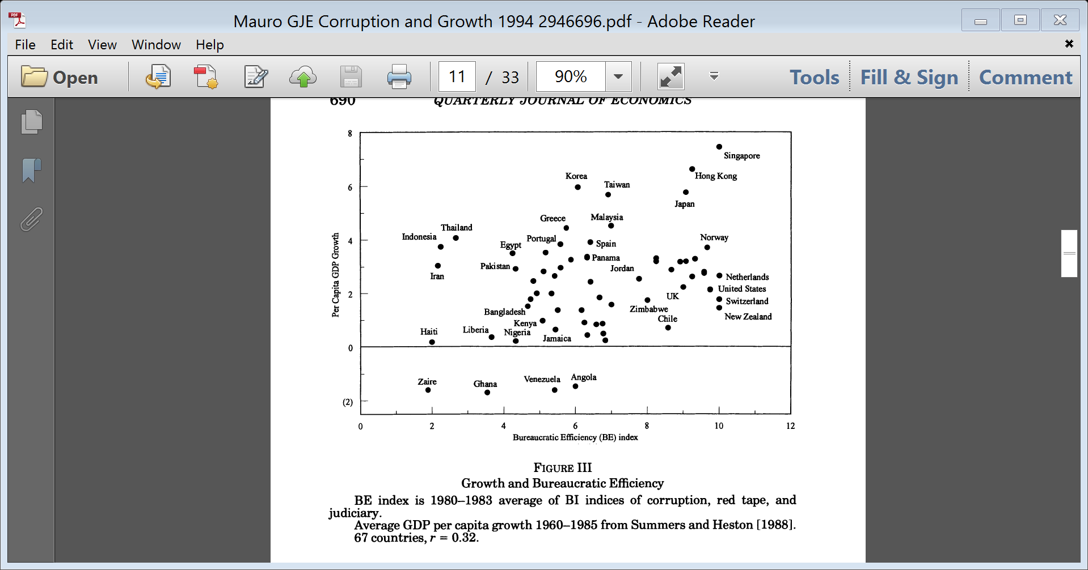
Corruption and growth

Slide 6
US Steel lost its competitiveness
Lobbying for protection = bribery
Lobbying leads to anti-dumping and voluntary export restrictions
Started anti-dumping in 74, finally VER1984
  Lobbying CEOs got bonuses (because of lobbying success)
  Non-lobbying oriented firms quit
  R&D dropped because R&D intensive firms quit
Copyrights Bernard Yeung 2015

Slide 7
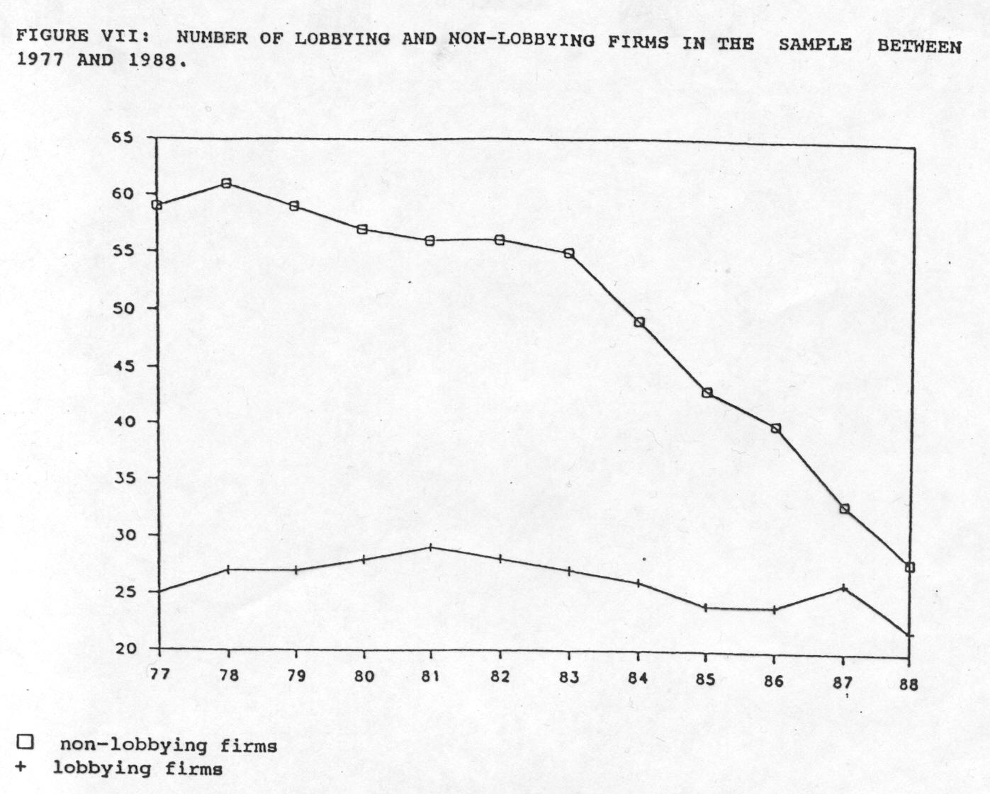
Copyrights Bernard Yeung 2015

Slide 8
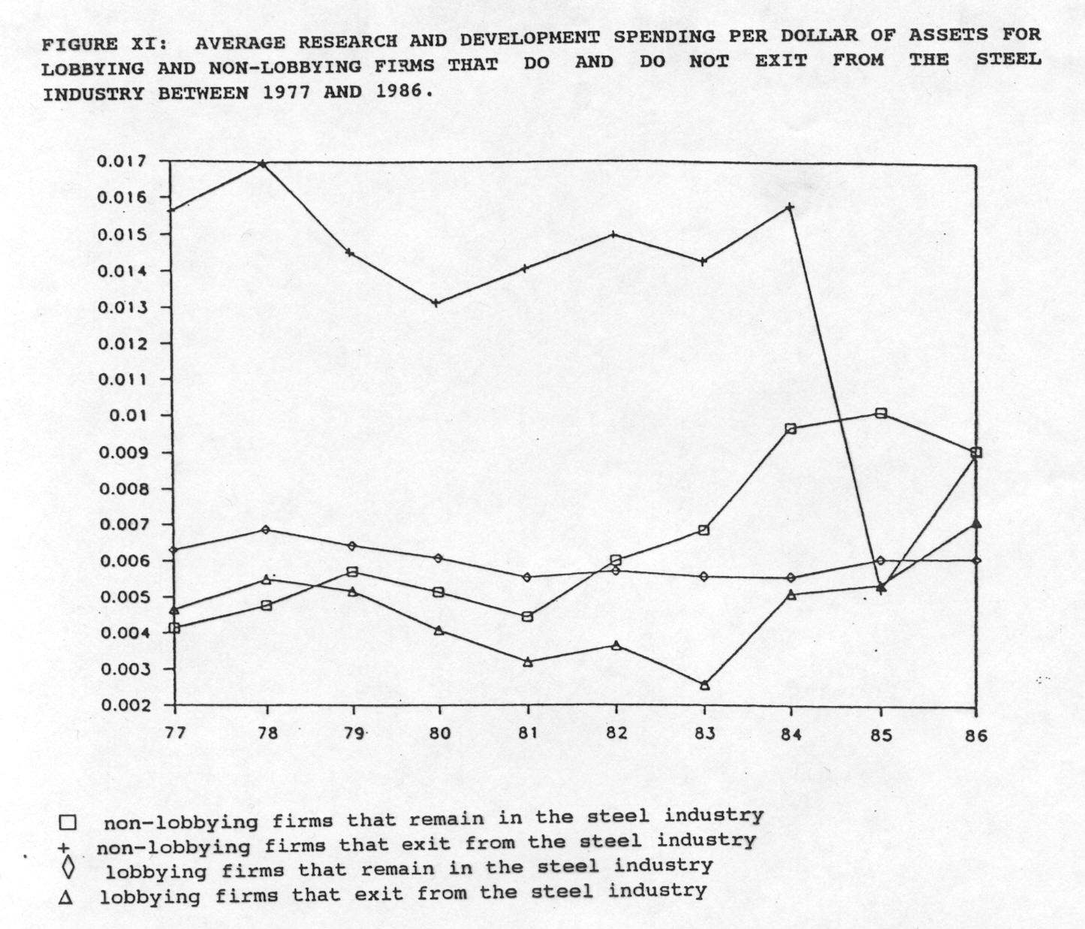

Slide 9
Why is getting rid of corruption difficult?
Bureaucratic resistance:
  Lose decision power and “opportunities” (cronyism is profitable for them)
  All have sinned in a large grey area
Benefits of anti-corruption depend on matching market institutions
  Need to pay bribery to get air passage to escape from bureaucratic choke?
Result in economics inertia?
  Low initial marginal benefits, high marginal cost
    Politicians prefer a quiet life
    Cooperative equilibrium?
Copyrights Bernard Yeung 2015

Slide 10
Prevalence of firms groups with dominant control is correlated with high bureaucracy & regulatory burdens
Copyrights Bernard Yeung 2015

Slide 11
Prevalence of firms groups with dominant control correlated with corrupt & non-credible government, little respect for rule of law & high level of rent-seeking
Copyrights Bernard Yeung 2015

Slide 12
Getting rid of corruption in China?
Dec 4th 2012, 8 regulations
  Just another power struggle?
  Necessary for CCP’s legitimacy?
Copyrights Bernard Yeung 2015

Slide 13
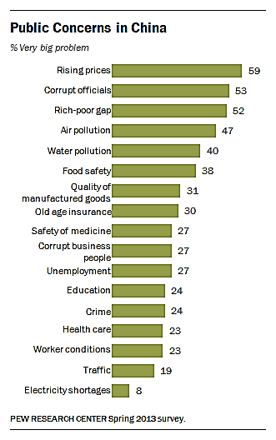
Public Concerns in China-2013 Survey
Copyrights Bernard Yeung 2015

Slide 14
Getting rid of corruption in China?
Dec 4th 2012, 8 regulations
  Just another power struggle?
  Necessary for CCP’s legitimacy?
  If real, will China succeed?
    Negative?
      Bureaucrats and firms stand still
      More distortions – private firms left with no air passage against strong bureaucratic bottlenecks
      Fleeing of capital
  Seek democratic economic opinion!
    Lin, Chen, Randall Morck, Bernard Yeung, and Xiaofeng Zhao 2015
Copyrights Bernard Yeung 2015

Slide 15
Very Positive Market Responses
Copyrights Bernard Yeung 2015

Slide 16
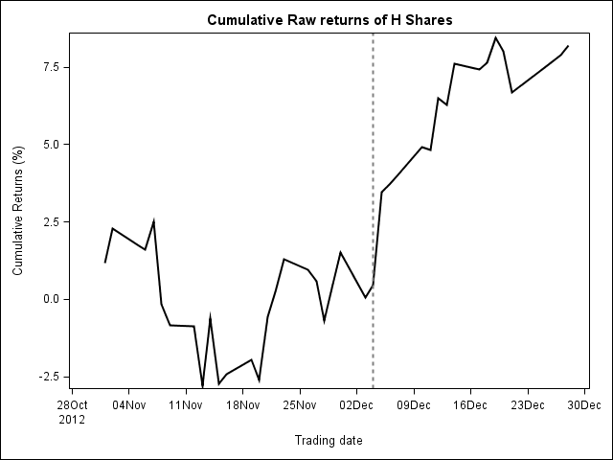
Collaborative evidence: H shares

Slide 17
Why positive market responses?
Xi-Li means business!
The positive outweighs the negative
  Anti-corruption reduces the transaction cost of doing business in the longer run, reduces waste in the short term
  More merit based allocation of resources in the longer run
  More development of value creating human capital
  Benefits of bribery to grease bureaucratic wheels not dominant
Copyrights Bernard Yeung 2015

Slide 18
Check using provincial level variations?
More marketized more gains?
Marketization index for China’s Provinces (National Economic Research Institute, NERI)
  Statistics or enterprise and household surveys.
  0 to 10 for 2001 (the base year)
    higher scores indicate high levels of marketization
    the index can go above 10 or below 0 in subsequent years
  We use 2011 data
Some sub-indices as examples:
  Government involvement in resource allocation (government expenses/GDP)
  Financial market development
    the level of deposit in non-state financial institutions
    share of bank loans to non-SOEs
  Legal environment
    the court's efficiency in resolving legal cases (producers and consumers)
    the strength of property rights and intellectual property rights protection
Copyrights Bernard Yeung 2015

Slide 19
Copyrights Bernard Yeung 2015

Slide 20
Stock market responses: high vs low marketization regions
Copyrights Bernard Yeung 2015

Slide 21
Regression of the cumulative raw returns of portfolios by provinces around the passage of the eight regulations

Slide 22
Economic Significance
Economic significance: CRR(-1, 1)
1 σ of GDP growth → 0.2% CRR
1 σ of Edu Exp. / GDP → 0.7% CRR
1 σ of Res. Allocation → 0.9% CRR
1 σ of Fin Sector M → 0.3% CRR
1 σ of Legal → 0.4% CRR
Copyrights Bernard Yeung 2015

Slide 23
Why higher return in more marketized regions?
High returns to firms in regions with
  Greater capabilities (higher HC)
  Greater growth potential
  Greater market institutions
    Less government (or rely less on government expenditures)
    Wider financial market access
    Better legal institution and property rights protection
→ Winners in merit based resource allocation
Copyrights Bernard Yeung 2015

Slide 24
Firm level returns
Don’t fully trust firm level data, but
  latest paper by Carpenter, Lu and Whitelaw supports China’s stock prices are more informed now
Differentiate along domicile location – high vs low marketization
Anti-corruption?
  Bribery intensive in the past?
    Use “Entertainment and Traveling Cost/ total assets” as a proxy
Deal with bureaucratic chokes?
  SOES vs POEs?
Copyrights Bernard Yeung 2015

Slide 25
Firm portfolio returns
Copyrights Bernard Yeung 2015

Slide 26
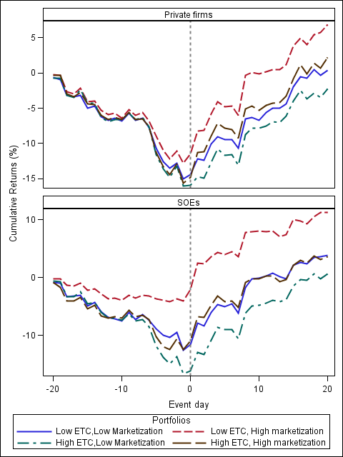
Raw Returns around the Passage of the Eight Regulations
Copyrights Bernard Yeung 2015

Slide 27
Observations
Bribery intensive firms gain less
SOEs gain more than POEs
  Anti-corruption is effective, make SOEs better investment prospects
  Yes, bureaucratic chokes matter
Institution development matters
  greater return in higher marketization regions
  greatest return in high marketized regions for low bribery intensity firms
Still, even in the worst category – high bribery intensity POEs in low marketization regions
  average portfolio returns is about 0
  % of losers < 50%
Copyrights Bernard Yeung 2015

Slide 28
Firm level CRR Regressions
Regression of firm level cumulative returns on initial level of productivity, external finance dependence, and growth opportunity. Total factor productivity is the Levinsohn-Petrin (2003) estimate of the total factor productivity. External finance dependence is the industry median of capital expenditures minus cash flow from operations divided by capital expenditures (Rajan and Zingales, 1998). Growth opportunity is measured by the industry median of Tobin's Q. In Panel A, the dependent variable is the 3-day cumulative raw returns. In Panel B, the dependent variable is the 5-day cumulative raw returns. All variables are defined in the Appendix A. Explainable variables are observed in the year 2011. Errors are clustered by industries and by provinces. The t statistics are reported in parentheses. Significance at the 10%, 5%, and 1% level is indicated by *, **, and ***, respectively.
Panel A: 3-day cumulative raw returns
Dep. Variables | CRR(-1, 1)
Sample | Private |  |  |  |  | SOEs
 | (1) | (2) | (3) | (4) |  | (5) | (6) | (7) | (8)
Marketization | 0.386** | 0.371** | 0.152* | 0.067 |  | 0.170* | 0.160* | 0.053 | -0.068
 | ( 2.35) | ( 2.11) | ( 1.74) | ( 0.34) |  | ( 1.91) | ( 1.85) | ( 0.87) | ( -0.21)
ETC | -1.675*** | -1.764*** | -1.516** | -8.404*** |  | 0.045 | 0.049 | 0.060 | -0.878
 | ( -2.63) | ( -2.84) | ( -2.49) | ( -3.37) |  | ( 0.39) | ( 0.48) | ( 0.61) | ( -0.97)
Marketization*Total factor productivity | 0.036** |  |  | 0.030* |  | 0.012 |  |  | 0.010
 | ( 2.19) |  |  | ( 1.82) |  | ( 1.09) |  |  | ( 1.06)
Marketization*External finance dependence (SIC) |  | 0.040** |  | 0.029** |  |  | 0.013 |  | 0.016
 |  | ( 2.42) |  | ( 2.02) |  |  | ( 1.37) |  | ( 1.39)
Marketization*Growth (SIC) |  |  | 0.279*** | 0.143** |  |  |  | 0.173** | 0.162**
 |  |  | ( 2.87) | ( 2.29) |  |  |  | ( 2.22) | ( 2.11)
Marketization*ETC |  |  |  | 1.284*** |  |  |  |  | 0.479**
 |  |  |  | ( 3.14) |  |  |  |  | ( 2.12)
GDP growth | 8.823** | 7.580* | 8.704* | 7.152* |  | 7.177* | 5.020 | 6.670 | 5.164
 | ( 2.02) | ( 1.87) | ( 1.95) | ( 1.82) |  | ( 1.73) | ( 1.10) | ( 1.37) | ( 1.02)
Log(GDP/capital) | 0.154 | 0.452 | 0.119 | 0.538 |  | 0.216 | 0.010 | 0.281 | 0.100
 | ( 0.31) | ( 0.76) | ( 0.24) | ( 0.90) |  | ( 0.58) | ( 0.02) | ( 0.76) | ( 0.23)
Education expenditures/GDP | 17.198 | 29.605* | 18.584 | 33.210* |  | 1.149 | 28.653 | 2.378 | 29.636
 | ( 0.88) | ( 1.79) | ( 0.94) | ( 1.87) |  | ( 0.08) | ( 1.22) | ( 0.16) | ( 1.37)
Control | Yes | Yes | Yes | Yes |  | Yes | Yes | Yes | Yes
Industry FE | Yes | No | No | Yes |  | Yes | No | No | Yes
Cluster | Ind, Prov | Ind, Prov | Ind, Prov | Ind, Prov |  | Ind, Prov | Ind, Prov | Ind, Prov | Ind, Prov
N | 1228 | 1228 | 1228 | 1228 |  | 1017 | 1017 | 1017 | 1017
Adj. R-squared | 27.79% | 18.78% | 20.69% | 32.65% |  | 19.92% | 10.83% | 12.56% | 25.82%

Slide 29
Firm level CRR Regressions
Regression of firm level cumulative returns on initial level of productivity, external finance dependence, and growth opportunity. Total factor productivity is the Levinsohn-Petrin (2003) estimate of the total factor productivity. External finance dependence is the industry median of capital expenditures minus cash flow from operations divided by capital expenditures (Rajan and Zingales, 1998). Growth opportunity is measured by the industry median of Tobin's Q. In Panel A, the dependent variable is the 3-day cumulative raw returns. In Panel B, the dependent variable is the 5-day cumulative raw returns. All variables are defined in the Appendix A. Explainable variables are observed in the year 2011. Errors are clustered by industries and by provinces. The t statistics are reported in parentheses. Significance at the 10%, 5%, and 1% level is indicated by *, **, and ***, respectively.
Panel B: 5-day cumulative raw returns
Dep. variables | CRR(-2, 2)
Sample | Private |  |  |  |  | SOEs
 | (1) | (2) | (3) | (4) |  | (5) | (6) | (7) | (8)
Marketization | 0.314** | 0.197* | 0.161 | 0.099 |  | 0.195** | 0.179* | 0.099 | -0.198
 | ( 2.17) | ( 1.73) | ( 1.41) | ( 0.21) |  | ( 2.05) | ( 1.93) | ( 0.91) | ( -1.10)
ETC | -1.759*** | -1.714*** | -1.415** | -9.429*** |  | 0.037 | 0.039 | 0.056 | -0.962
 | ( -2.84) | ( -2.88) | ( -2.39) | ( -3.45) |  | ( 0.35) | ( 0.39) | ( 0.75) | ( -1.12)
Marketization*Total factor productivity | 0.030* |  |  | 0.023 |  | 0.009 |  |  | 0.007
 | ( 1.83) |  |  | ( 1.45) |  | ( 0.94) |  |  | ( 0.83)
Marketization*External finance dependence (SIC) |  | 0.042** |  | 0.036** |  |  | 0.014 |  | 0.013
 |  | ( 2.44) |  | ( 2.10) |  |  | ( 1.52) |  | ( 1.19)
Marketization*Growth (SIC) |  |  | 0.294** | 0.194** |  |  |  | 0.189** | 0.124**
 |  |  | ( 2.51) | ( 2.13) |  |  |  | ( 2.27) | ( 1.98)
Marketization*ETC |  |  |  | 1.326*** |  |  |  |  | 0.522**
 |  |  |  | ( 3.33) |  |  |  |  | ( 2.37)
GDP growth | 7.379* | 7.581* | 7.572* | 7.279* |  | 5.953 | 4.878 | 5.246 | 4.905
 | ( 1.86) | ( 1.90) | ( 1.84) | ( 1.69) |  | ( 1.35) | ( 1.05) | ( 1.28) | ( 1.18)
Log(GDP/capital) | 0.586 | 0.749 | 0.903 | 0.839 |  | 0.444 | 0.223 | 0.659 | 0.734
 | ( 1.10) | ( 1.29) | ( 1.64) | ( 1.63) |  | ( 0.97) | ( 0.81) | ( 1.10) | ( 1.16)
Education expenditures/GDP | 14.777 | 23.140* | 17.362 | 28.382* |  | 2.375 | 22.291 | 3.729 | 25.126
 | ( 0.78) | ( 1.70) | ( 0.84) | ( 1.77) |  | ( 0.18) | ( 1.03) | ( 0.23) | ( 1.11)
Control | Yes | Yes | Yes | Yes |  | Yes | Yes | Yes | Yes
Industry FE | Yes | No | No | Yes |  | Yes | No | No | Yes
Cluster | Ind, Prov | Ind, Prov | Ind, Prov | Ind, Prov |  | Ind, Prov | Ind, Prov | Ind, Prov | Ind, Prov
N | 1228 | 1228 | 1228 | 1228 |  | 1017 | 1017 | 1017 | 1017
Adj. R-squared | 23.32% | 15.17% | 16.09% | 29.64% |  | 18.48% | 9.36% | 11.52% | 24.80%

Slide 30
Regression analyses
High tfp POE firms gain
  more so in high marketization regions
High external financing-dependent POE firms gain
  more so in high marketization regions
Generically, high growth potential firms gain
  more so in high marketization regions
High bribery intensity firms lose
  More so in low marketization regions
    Face greater bureaucratic chokes
Yet SOE firms gain more than POE firms because they suffer less from bureaucratic chokes
  Especially in high marketization regions
    Anti-corruption mitigates self-dealing and wasteful behavior?
Copyrights Bernard Yeung 2015

Slide 31
Conclusions
Investors think anti-corruption in China is real and it creates value
Make SOEs better investment prospects
  Mitigate self-dealing and waste?
Bureaucratic chokes matter, but not bad enough
  Even high bribery intensive firms in low marketization regions do not lose on average
Expecting more merit-based resource allocations
  Reward more productive firms with more external financing dependence in more marketized provinces with growth potential and higher level of HC
Anti-corruption needs institutional development
Copyrights Bernard Yeung 2015

Slide 32
Research can help
Our results broadly support current policy direction
But, only conjectural, clearly not definitive
Short of details and insights on execution
Need more penetrating investigation
Copyrights Bernard Yeung 2015

Slide 33
Research can help
How can countries evolve (or not?) away from corruption?
Speculation/Observation
  Powerful (& credibly non-corrupt) leader
  Separation of business from government & Party
  Judicial independence – from rest-of-government (executive, legislature, bureaucracy) & Party
  Mass media independent of government & Party
  Amnesty
  Education at the very early age
Copyrights Bernard Yeung 2015

Slide 34

Copyrights Bernard Yeung 2015

