Slide 1
Global Capital Flows and Regulation of SIFIs
INET CIGI HKIMR CONFERENCE
CHINA AND THE WORLD ECONOMY
Hong Kong , 23 June, 2014
Adair Turner
Senior Fellow, Institute of New Economic Thinking
www.ineteconomics.org | www.facebook.com/ineteconomics
300 Park Avenue South - 5th Floor
New York, NY 10010

Slide 2
Global current account balances as a % of world GDP

Slide 3
Eurozone current account deficits:
2000 – 2008
Greece
% of GDP
% of GDP 2000 – 2008
Ireland
Portugal
Spain
Source: International Monetary Fund, World Economic Outlook Database, October 2012

Slide 4
Private domestic credit as a % of GDP:
Advanced economies 1950 – 2011
Source: Financial and Sovereign Debt Crises: Some Lessons Learned and Those Forgotten, C. Reinhart & K. Rogoff, 2013

Slide 5
China: total social finance to GDP
% of GDP

Slide 6
Non-financial private sector* credit outstanding: % of GDP
Source: BIS, Citi Research
*Households + corporates

Slide 7
Measures of increasing financial intensity
300%
US debt as a % of GDP by borrower type
250%
200%
Corporate
150%
Household
100%
50%
Financial
10%
1929
1935
1941
1947
1953
1959
1965
1971
1977
1983
1990
1996
2002
2007

Slide 8
US financial sector assets
Banks
MMMFs
GSE
Agency and GSE- Mortgage Pools
Issuers of ABS
Finance Companies
300%
Security Broker-Dealer
Funding Corporation
250%
200%
150%
100%
50%
0%
1960
1965
1970
1975
1980
1985
1990
1995
2000
2005
2010

Slide 9
Categories of debt: UK 2009
£bn
Other corporate
Primarily productive investment
Some productive investment and some leveraged asset play
Commercial real estate
Residential mortgage (including securitizations and loan transfers)
Mainly purchase of existing assets
Unsecured personal
Pure life-cycle consumption smoothing

Slide 10
Credit and asset price cycles
Increased credit extended
Increased borrower demand for credit
Increased asset prices
Increased lender supply of credit
Expectation of future asset price increases
Favourable assessments of credit risk
Low credit losses: high bank profits
Confidence reinforced
Increased capital base

Slide 11
Interactions between credit categories and effects
Reduced saving: increased consumption
Increased apparent wealth
Increasing credit supply / demand
Increased price of existing real estate
Increased prices for new real estate
Boom in new real estate construction
Borrower and lender net worth, confidence and expectational effects
Equity withdrawal mortgage supply & demand

Slide 12
Categories of net capital flow effects
Finance for new real estate construction boom
Over-investment cycle and debt overhang
Spain, Ireland, US
Finance for existing real estate purchase
Credit and asset price cycle and debt overhang
UK
(And Spain, Ireland, US)
Finance of unsustainable consumption
Debt overhang
US in particular

Slide 13
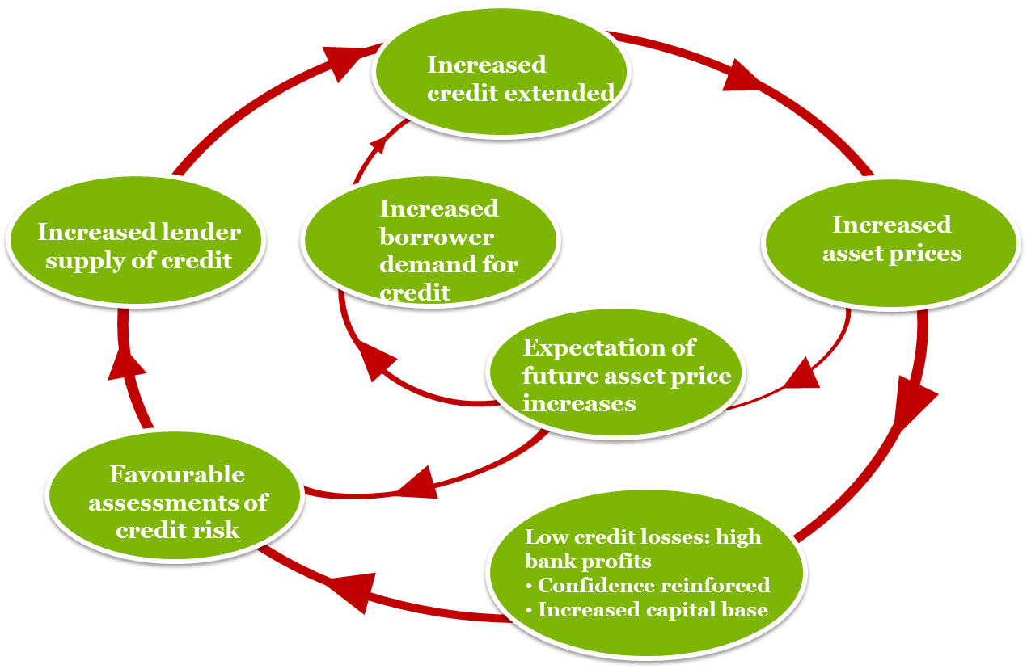
Net capital flows and domestic credit cycles
Credit and asset price cycles
Increased debt finance of:
Real estate
Consumption
Structural drivers of current account imbalance
Wealth effects and increased consumption
Domestic banking system creation of credit and matching money
Total increase in credit and subsequent debt overhang a large multiple of the net international capital flows

Slide 14
Total cross-border capital inflows:
1980 – 2011
12
Foreign direct investment
10
Equity
8
Bonds
Loans and deposits
5.8
6
4.8
USD trillions, constant 2011 exchange rates
4.9
4
2
2.0
0
-2
-4
1990
1995
2000
2005
2007
2011
% Global GDP
5
5
13
15
21
7
Source: Future of Long-term Finance, Group of Thirty Report, MGI, December 2012

Slide 15
Coefficient of variation of inward cross-border runs by type
Emerging Markets
Short maturity
Long maturity
Developed Markets
Short-term bank claims
Long-term bank claims
Bonds
Equity
FDI
Source: Future of Long-term Finance, Group of Thirty Report, MGI, December 2012

