Slide 1
China: Macro Outlook, Financial Risks and Reforms
Jun Ma, Deutsche Bank
March 2014
Deutsche Bank does and seeks to do business with companies covered in its research reports. Thus, investors should be aware that the firm may have a conflict of interest that could affect the objectivity of this report. Investors should consider this report as only a single factor in making their investment decision. DISCLOSURES AND ANALYST CERTIFICATIONS ARE LOCATED IN APPENDIX 1. MICA(P) 054/04/2013.
Jun Ma (852) 2203 8308, jun.ma@db.com

Slide 2
Growth outlook

Slide 3
Short-term headwind: emergency measures to fight PM2.5 negatively affected industrial activities in past 3 months
In Hebei, the government suspended production of more than 8000 companies in heavy manufacturing companies to control air pollution;
Beijing announces that it shuts down a few hundred factories in days with PM2.5 exceeding threshold;
Many other cities also implement “emergency measures” to control emissions in the winter, where PM2.5 is seasonally the highest

Slide 4
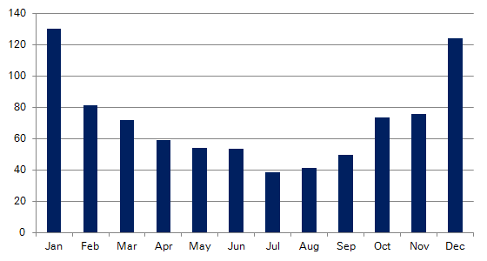
Seasonality of PM2.5 index level in 74 Chinese cities
Source: DB compilation

Slide 5
Other short-term headwinds
Extremely cold US weather
Geopolitical tensions and EM currency volatility
Sentiment impact of China’s trust loan and bond defaults

Slide 6
Driver of recovery # 1: G3 demand for China exports to rise
G3 GDP growth forecast, yoy %
Source: Deutsche Bank, CEIC

Slide 7
Driver of recovery # 2: Real estate FAI will likely accelerate this year on stronger pre-sales in 2013
China property sales growth leading sector FAI
Source: Deutsche Bank, CEIC

Slide 8
Driver of recovery # 3: Deregulation and SOE reforms to drive stronger private sector investment
Share of SOEs in GDP (or assets) by sector: China vs. developed countries
Source: OECD, NBS, DB estimates

Slide 9
A few financial risks

Slide 10
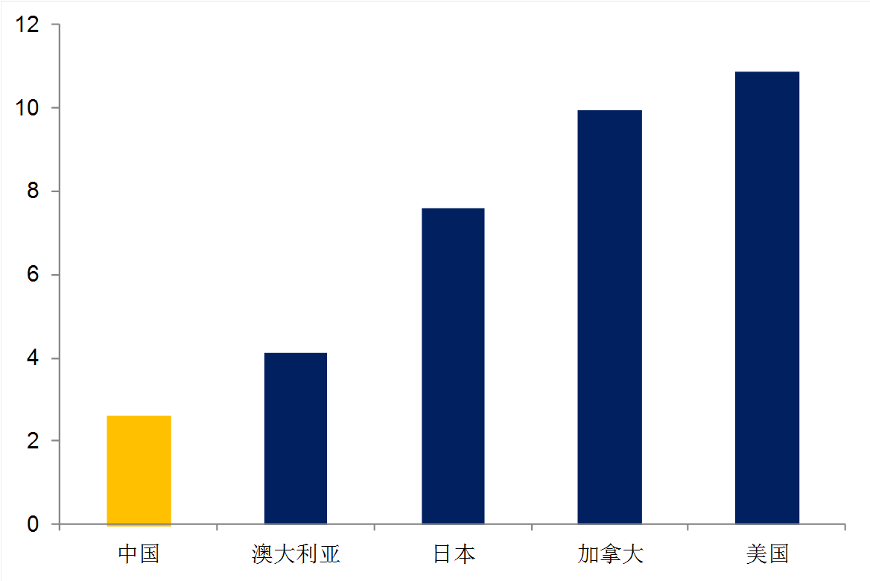
Refinancing risk of local government debt
Average maturity of local govt debt, in number of years

Slide 11
Mispricing of credit risks
In the US, there are 50 municipal bond defaults per year, while the number of defaults was zero in China until last month.
There is a strong perception of implicit guarantees for local govt debt, trust loans, and other types of WMPs.

Slide 12
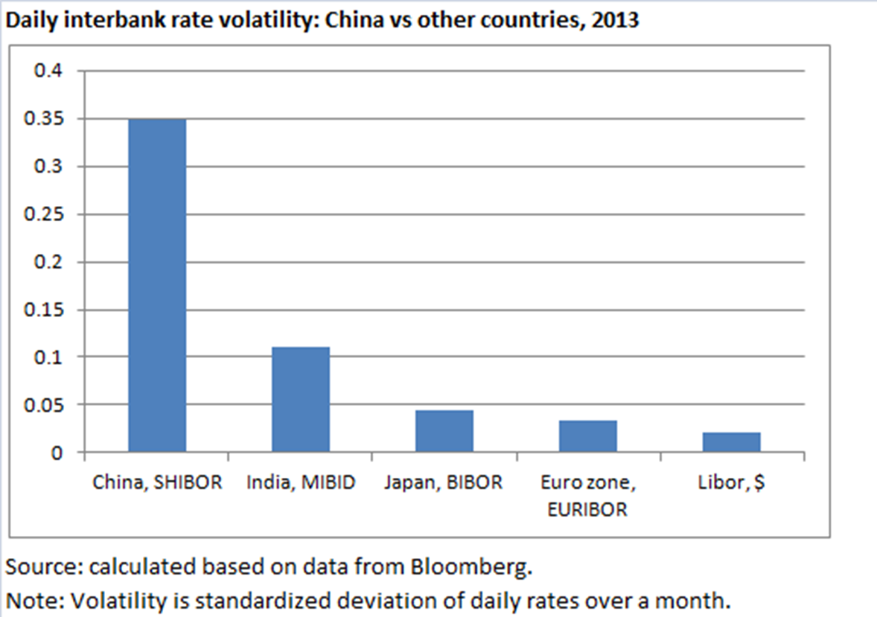
Excessive volatility of interest rates
High MM volatility tends to distort market expectations and adversely affect investment decisions, and could attract excessive carry trades

Slide 13
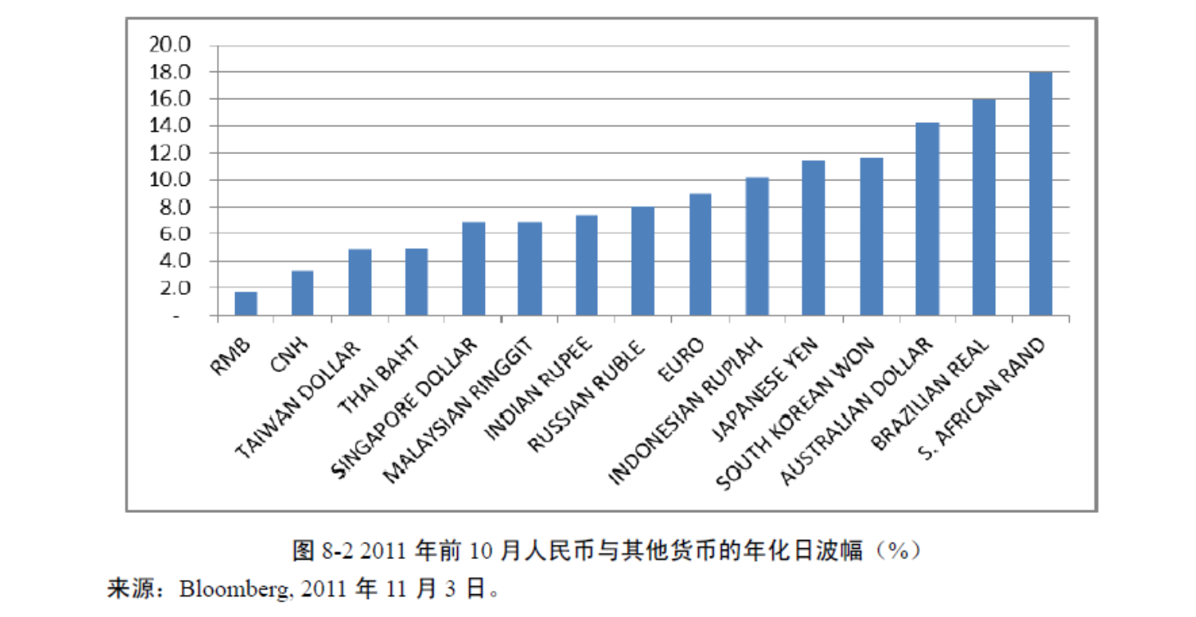
Lack of exchange rate flexibility
Opening of the capital account without sufficient exchange rate flexibility invites interest rate arbitrages and shocks to domestic market

Slide 14
Reforms

Slide 15
During the move towards interest rate and capital account liberalization, a few more things should be done:
1. Developing a local government bond market.
2. Correcting mispricing of credit risk by permitting “managed defaults”.
Speeding up the establishment a deposit insurance scheme.
Moving more quickly towards interest rate targeting for monetary policy operation. The ECB model looks most interesting.
5. Increasing RMB flexibility by more aggressively reducing FX intervention.

Slide 16
Appendix
Important Disclosures
Additional Information Available upon Request
For disclosures pertaining to recommendations or estimates made on securities other than the primary
subject of this research, please see the most recently published company report or visit our global
disclosure look-up page on our website at http://gm.db.com/ger/disclosure/DisclosureDirectory.eqsr
Analyst Certification
The views expressed in this report accurately reflect the personal views of the undersigned lead analyst(s). In addition, the undersigned lead analyst(s) has not and will not receive any compensation for providing a specific recommendation or view in this report. Jun Ma
18/03/2014 10:42:17
2010 DB Blue template
Notes:
16
18 March 2014

Slide 17
Regulatory Disclosures
1. Important Additional Conflict Disclosures
Aside from within this report, important conflict disclosures can also be found at https://gm.db.com/equities under the “Disclosures Lookup” and “Legal” tabs. Investors are strongly encouraged to review this information before investing.
2. Short-Term Trade Ideas
Deutsche Bank equity research analysts sometimes have shorter-term trade ideas (known as SOLAR ideas) that are consistent or inconsistent with Deutsche Bank’s existing longer term ratings. These trade ideas can be found at the SOLAR link at http://gm.db.com.
3. Country-Specific Disclosures
Australia and New Zealand: This research, and any access to it, is intended only for "wholesale clients" within the meaning of the Australian Corporations Act and New Zealand Financial Advisors Act respectively.
Brazil: The views expressed above accurately reflect personal views of the authors about the subject company(ies) and its(their) securities, including in relation to Deutsche Bank. The compensation of the equity research analyst(s) is indirectly affected by revenues deriving from the business and financial transactions of Deutsche Bank. In cases where at least one Brazil based analyst (identified by a phone number starting with +55 country code) has taken part in the preparation of this research report, the Brazil based analyst whose name appears first assumes primary responsibility for its content from a Brazilian regulatory perspective and for its compliance with CVM Instruction # 483.
EU countries: Disclosures relating to our obligations under MiFiD can be found at http://www.globalmarkets.db.com/riskdisclosures.
Japan: Disclosures under the Financial Instruments and Exchange Law: Company name - Deutsche Securities Inc. Registration number - Registered as a financial instruments dealer by the Head of the Kanto Local Finance Bureau (Kinsho) No. 117. Member of associations: JSDA, Type II Financial Instruments Firms Association, The Financial Futures Association of Japan, Japan Investment Advisers Association. Commissions and risks involved in stock transactions - for stock transactions, we charge stock commissions and consumption tax by multiplying the transaction amount by the commission rate agreed with each customer. Stock transactions can lead to losses as a result of share price fluctuations and other factors. Transactions in foreign stocks can lead to additional losses stemming from foreign exchange fluctuations. "Moody's", "Standard & Poor's", and "Fitch" mentioned in this report are not registered credit rating agencies in Japan unless “Japan” or "Nippon" is specifically designated in the name of the entity. Reports on Japanese listed companies not written by analysts of Deutsche Securities Inc. (DSI) are written by Deutsche Bank Group's analysts with the coverage companies specified by DSI.
Russia: This information, interpretation and opinions submitted herein are not in the context of, and do not constitute, any appraisal or evaluation activity requiring a license in the Russian Federation.
18/03/2014 10:42:17
2010 DB Blue template
Notes:
17
18 March 2014

Slide 18
Global Disclaimer
The information herein is believed to be reliable and has been obtained from public sources believed to be reliable. Deutsche Bank makes The information and opinions in this report were prepared by Deutsche Bank AG or one of its affiliates (collectively "Deutsche Bank"). The information herein is believed to be reliable and has been obtained from public sources believed to be reliable. Deutsche Bank makes no representation as to the accuracy or completeness of such information.
Deutsche Bank may engage in securities transactions, on a proprietary basis or otherwise, in a manner inconsistent with the view taken in this research report. In addition, others within Deutsche Bank, including strategists and sales staff, may take a view that is inconsistent with that taken in this research report.
Opinions, estimates and projections in this report constitute the current judgement of the author as of the date of this report. They do not necessarily reflect the opinions of Deutsche Bank and are subject to change without notice. Deutsche Bank has no obligation to update, modify or amend this report or to otherwise notify a recipient thereof in the event that any opinion, forecast or estimate set forth herein, changes or subsequently becomes inaccurate. Prices and availability of financial instruments are subject to change without notice. This report is provided for informational purposes only. It is not an offer or a solicitation of an offer to buy or sell any financial instruments or to participate in any particular trading strategy. Target prices are inherently imprecise and a product of the analyst judgement.
As a result of Deutsche Bank’s March 2010 acquisition of BHF-Bank AG, a security may be covered by more than one analyst within the Deutsche Bank group. Each of these analysts may use differing methodologies to value the security; as a result, the recommendations may differ and the price targets and estimates of each may vary widely.
In August 2009, Deutsche Bank instituted a new policy whereby analysts may choose not to set or maintain a target price of certain issuers under coverage with a Hold rating. In particular, this will typically occur for "Hold" rated stocks having a market cap smaller than most other companies in its sector or region. We believe that such policy will allow us to make best use of our resources. Please visit our website at http://gm.db.com to determine the target price of any stock.
The financial instruments discussed in this report may not be suitable for all investors and investors must make their own informed investment decisions. Stock transactions can lead to losses as a result of price fluctuations and other factors. If a financial instrument is denominated in a currency other than an investor's currency, a change in exchange rates may adversely affect the investment. Past performance is not necessarily indicative of future results. Deutsche Bank may with respect to securities covered by this report, sell to or buy from customers on a principal basis, and consider this report in deciding to trade on a proprietary basis.
Unless governing law provides otherwise, all transactions should be executed through the Deutsche Bank entity in the investor's home jurisdiction. In the U.S. this report is approved and/or distributed by Deutsche Bank Securities Inc., a member of the NYSE, the NASD, NFA and SIPC. In Germany this report is approved and/or communicated by Deutsche Bank AG Frankfurt authorized by the BaFin. In the United Kingdom this report is approved and/or communicated by Deutsche Bank AG London, a member of the London Stock Exchange and regulated by the Financial Services Authority for the conduct of investment business in the UK and authorized by the BaFin. This report is distributed in Hong Kong by Deutsche Bank AG, Hong Kong Branch, in Korea by Deutsche Securities Korea Co. This report is distributed in Singapore by Deutsche Bank AG, Singapore Branch or Deutsche Securities Asia Limited, Singapore Branch, and recipients in Singapore of this report are to contact Deutsche Bank AG, Singapore Branch or Deutsche Securities Asia Limited, Singapore Branch in respect of any matters arising from, or in connection with, this report. Where this report is issued or promulgated in Singapore to a person who is not an accredited investor, expert investor or institutional investor (as defined in the applicable Singapore laws and regulations), Deutsche Bank AG, Singapore Branch or Deutsche Securities Asia Limited, Singapore Branch accepts legal responsibility to such person for the contents of this report. In Japan this report is approved and/or distributed by Deutsche Securities Inc. The information contained in this report does not constitute the provision of investment advice. In Australia, retail clients should obtain a copy of a Product Disclosure Statement (PDS) relating to any financial product referred to in this report and consider the PDS before making any decision about whether to acquire the product. Deutsche Bank AG Johannesburg is incorporated in the Federal Republic of Germany (Branch Register Number in South Africa: 1998/003298/10). Additional information relative to securities, other financial products or issuers discussed in this report is available upon request. This report may not be reproduced, distributed or published by any person for any purpose without Deutsche Bank's prior written consent. Please cite source when quoting.
Copyright © 2013 Deutsche Bank AG

