Slide 1
China After the Plenum
Steven Barnett
Division Chief
IMF Asia and Pacific Department
January 2014
The views expressed in this presentation are those of the author and do not necessarily represent those of the IMF or IMF policy.

Slide 2
Slower but better growth…

Slide 3
…sustainable, inclusive, & green.
Notes:
So the lesson I would draw from China’s history, is that China’s economic success came not from the staying the course, but rather from the willingness to change course. And, indeed, China’s leaderships has made very clear their intention to pursue a range of structural reforms to ensure that China’s economy changes course again. Changes course to a more balanced and sustainable growth path.

Slide 4
…credit growth has also risen…

Slide 5
…via off-budget fiscal spending.

Slide 6
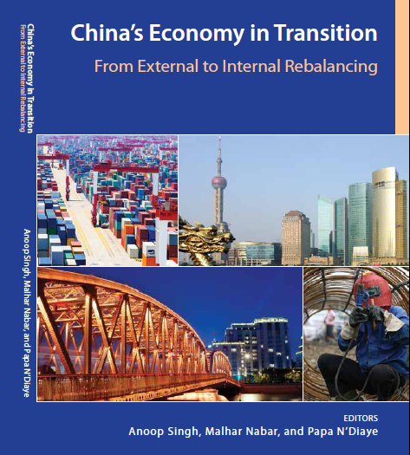
Further reading
People’s Republic of China: 2013 Article IV Report
http://www.imf.org/external/pubs/cat/longres.aspx?sk=40786.0
China’s Growth: Why Less is More
(Blog : Steven Barnett; 29-Oct-13)
http://blog-imfdirect.imf.org/2013/10/29/chinas-growth-why-less-is-more/
IMF and PBC Joint Conference on Capital Flows Management: Lessons from International Experience
www.imf.org/external/np/seminars/eng/2013/capitalflows/pdf/032013.pdf

Slide 7
Thank you

